Slide 1
Introduction to Convolutional Neural Network
CSE301 Bio-computation Week 6, Oct 19, 2015
Bailing Zhang

Slide 2

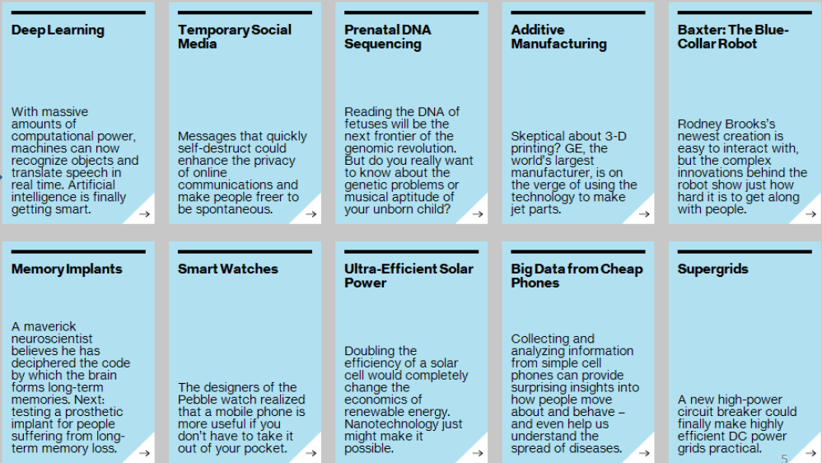
Impact of Deep Learning

Slide 3
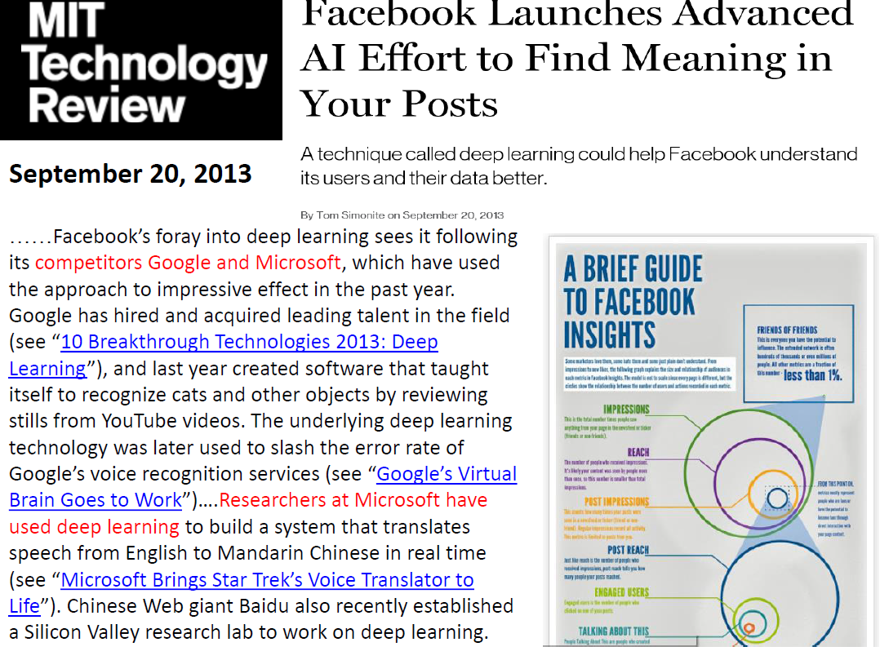

Slide 4
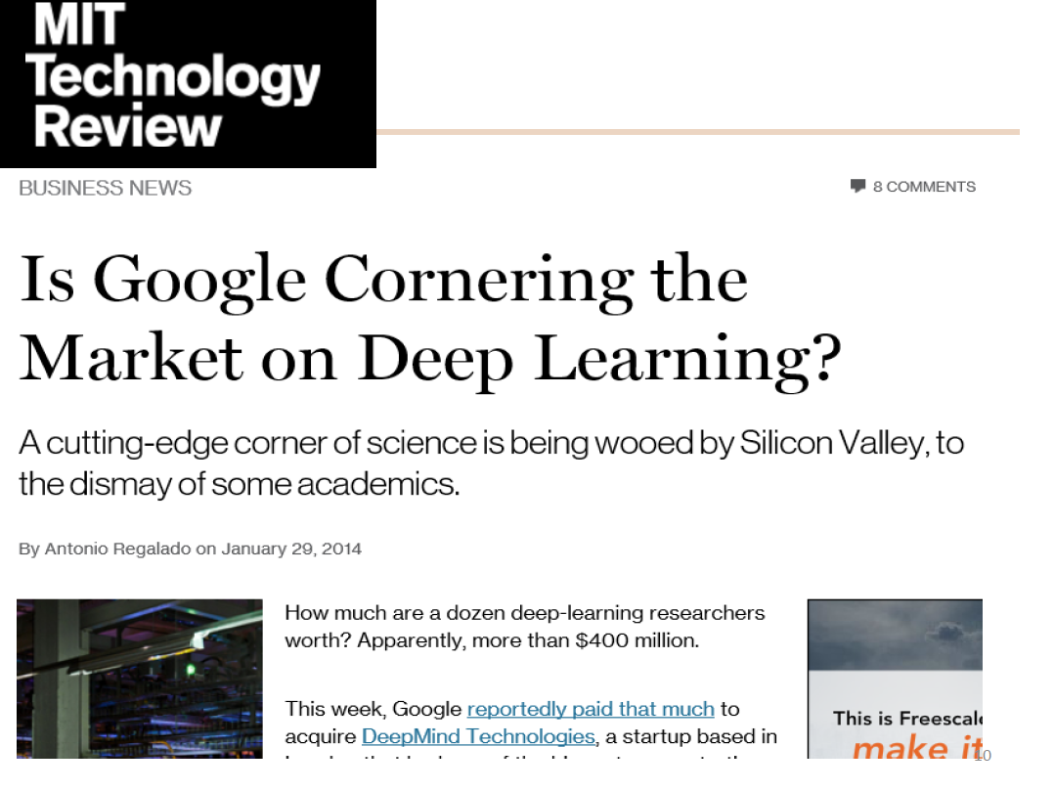

Slide 5
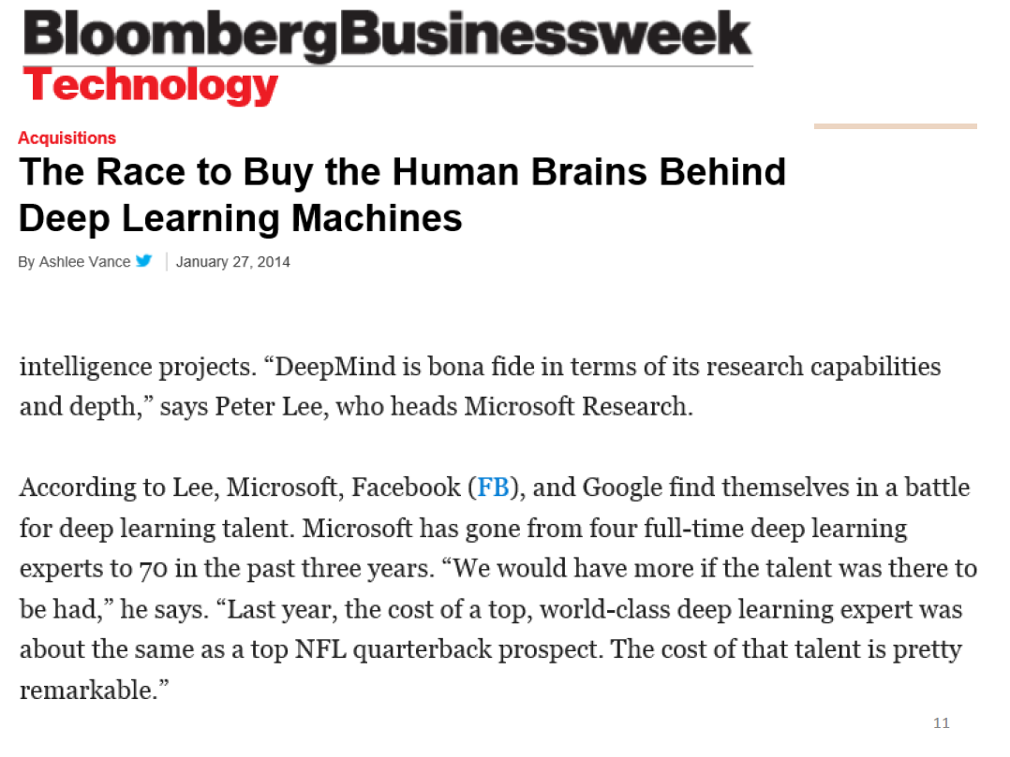

Slide 6


Slide 7


Slide 8
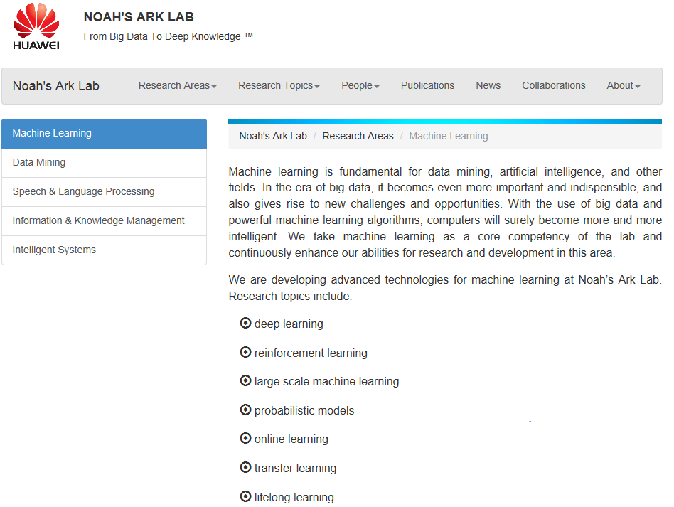

Slide 9

Deep Learning – from Research to Technology
Deep Learning - breakthrough in visual and speech recognition

Slide 10
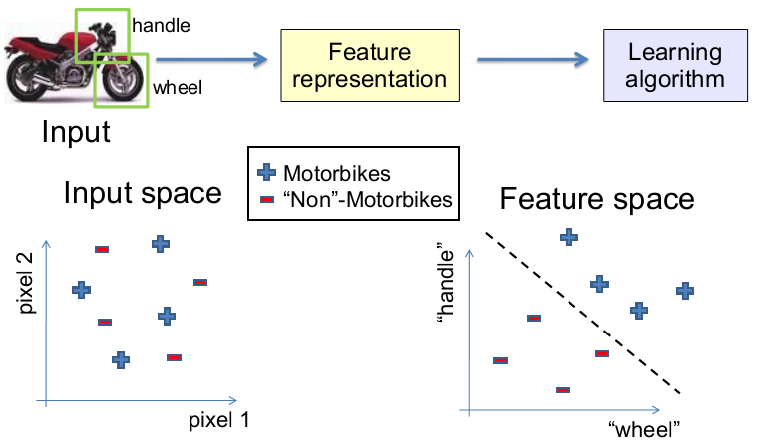
Background of Deep Learning (1) Feature Representations

Slide 11
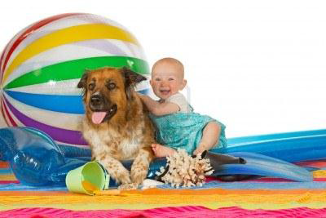
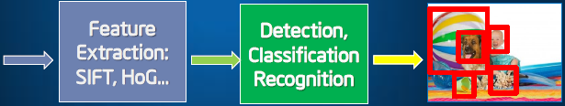
Classical Computer Vision Pipeline
1.Select / develop features ( e.g., SURF, HoG, SIFT, RIFT, …)
2.Add on top of this Machine Learning for recognition and train classifier
Classical CV feature definition is domain-specific, hand engineered, and time-consuming

Slide 12

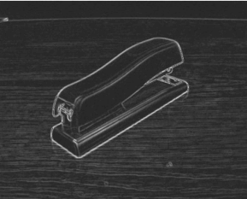

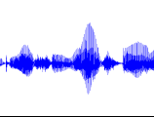
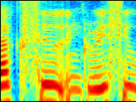


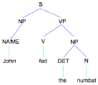
Features for machine learning
image
Image feature
Object detection
audio
Audio feature
Speaker ID
Web search
text
Text feature

Slide 13
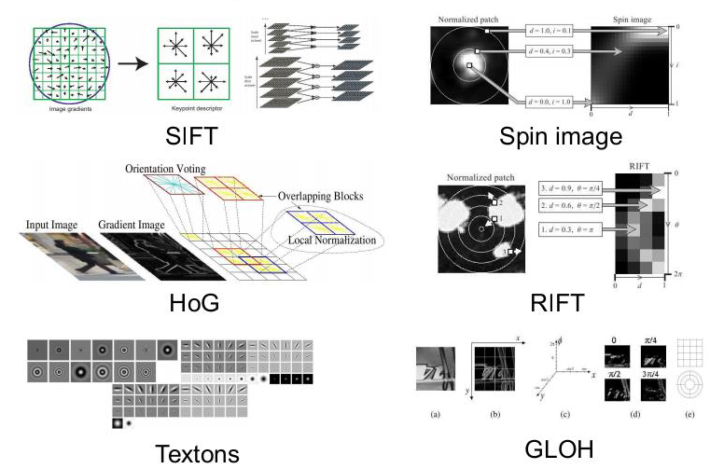
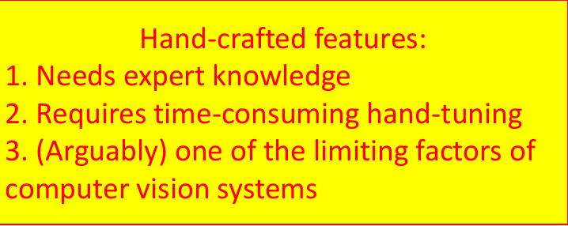
Computer vision features

Slide 14
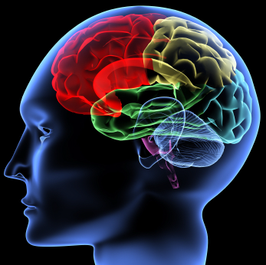
Learning Feature Representations
The idea:
Most perception (input processing) in the brain may be due to one learning algorithm.
Build learning algorithms that mimic the brain.
Most of human intelligence may be due to one learning algorithm.
one learning algorithm end-to-end system!

Slide 15
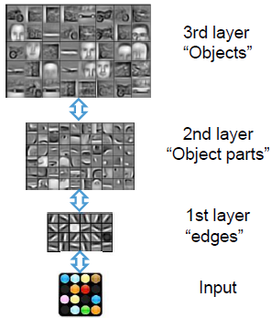
Background of Deep Learning (2) Learning Feature Hierarchy
Deep Learning
– Deep architectures can be representationally efficient.
– Natural progression from low level to high level structures.
– Can share the lower-level representations for multiple tasks.

Slide 16
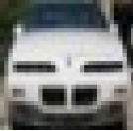
End-to-end Object Recognition System
“car”
Feature
extractor
classifier
How to use data to optimize features for the given task?
– Everything becomes adaptive.
– No disticntion between feature extractor and classifier.
– Big non-linear system trained from raw pixels to labels

Slide 17
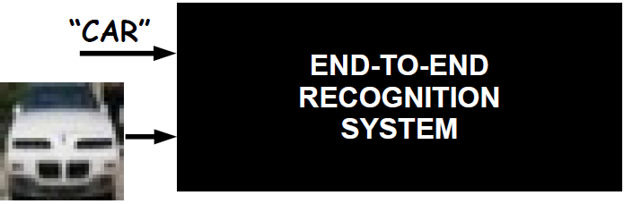
End-to-end Object Recognition System
Q: How can we build such a highly non-linear system?
A: By combining simple building blocks we can make more and more complex systems.

Slide 18
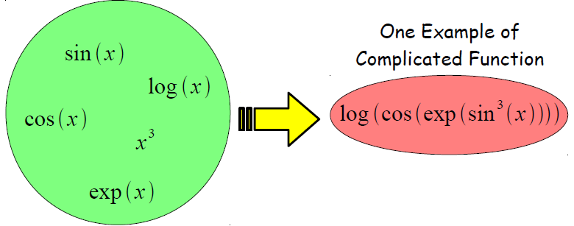
Building A Complicated Function
Simple Functions
– Function composition is at the core of deep learning methods.
– Each “simple function” will have parameters subject to training.

Slide 19
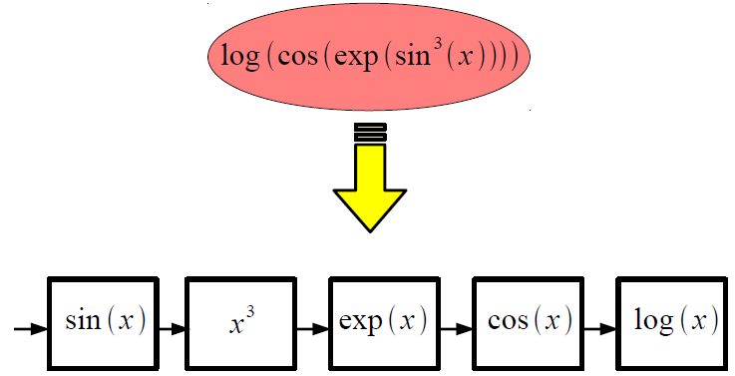
Implementing A Complicated Function
Complicated Function

Slide 20
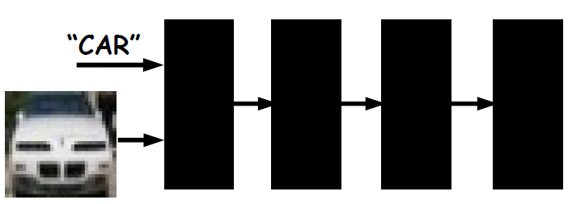
Intuition Behind Deep Neural Nets
NOTE: Each black box can have trainable parameters.
Their composition makes a highly non-linear system.

Slide 21
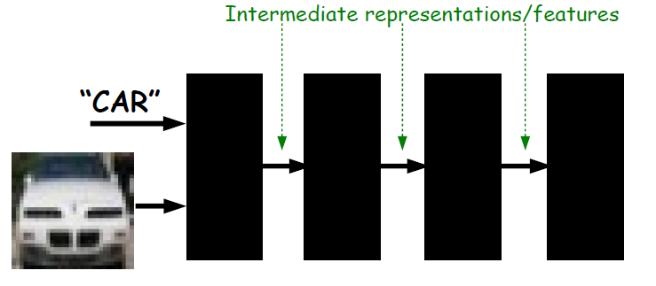
Intuition Behind Deep Neural Nets
NOTE: System produces a hierarchy of features

Slide 22
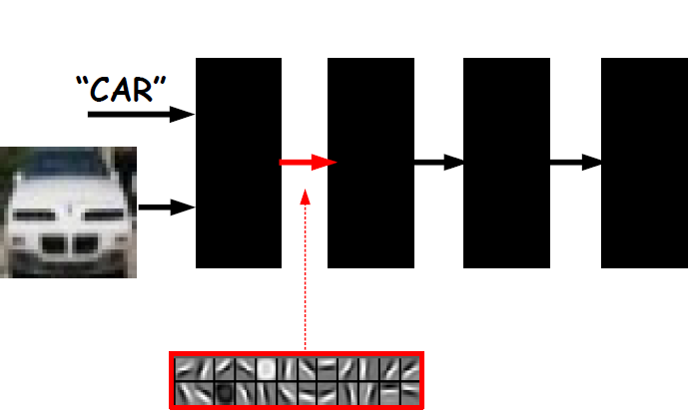
Intuition Behind Deep Neural Nets

Slide 23
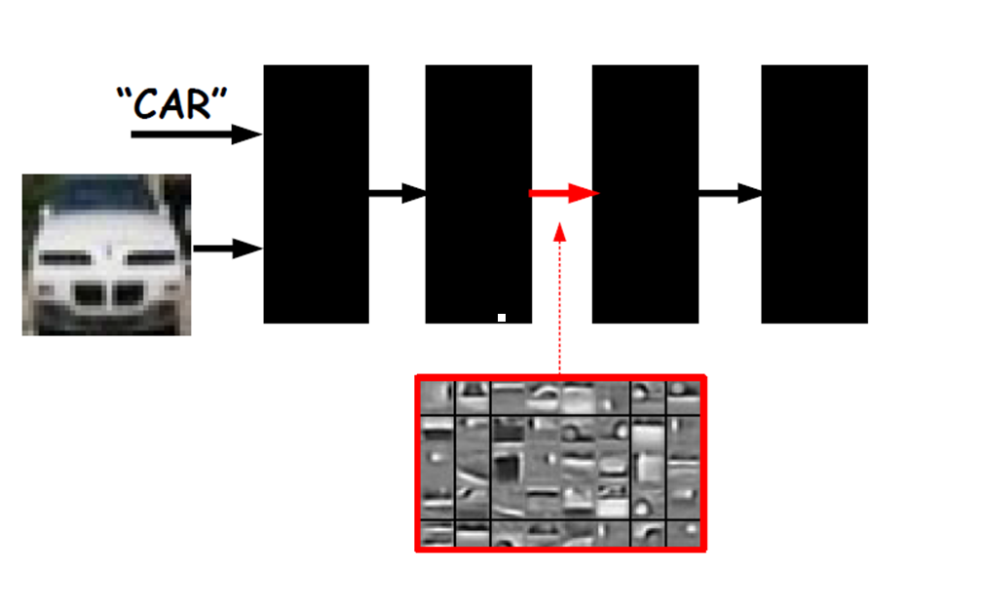

Slide 24
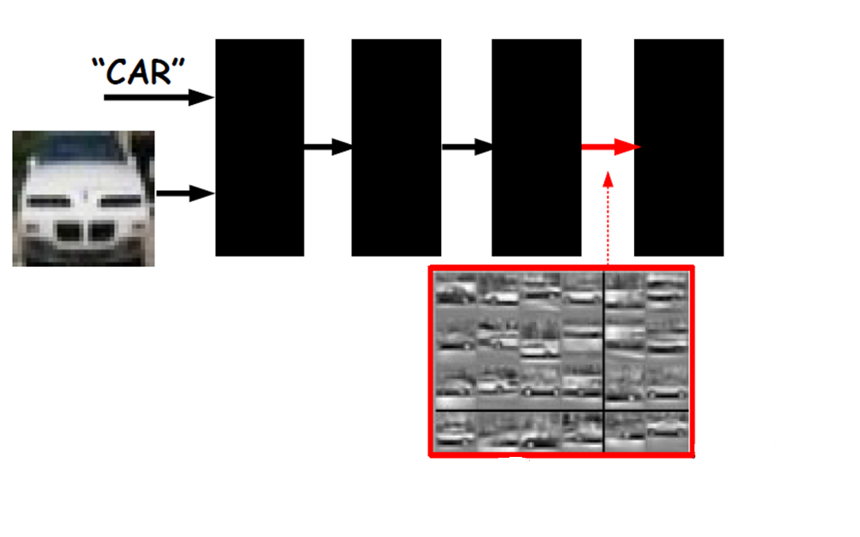

Slide 25
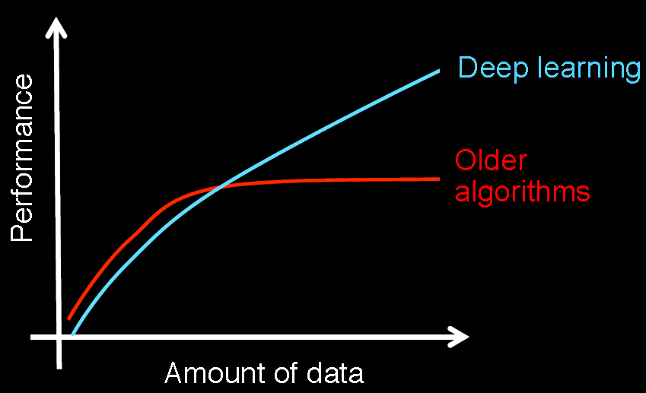
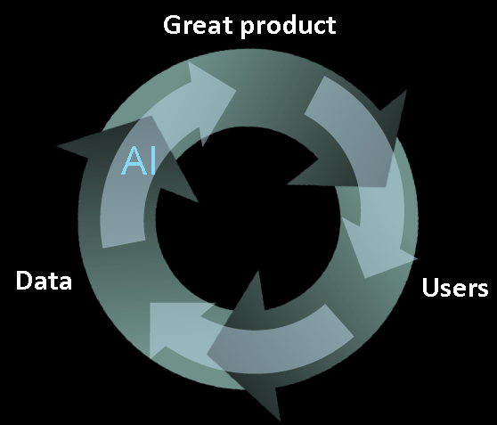
Background of Deep Learning (3) driving force from big data
Virtuous circle of AI
Learning from data

Slide 26
Summarizing Key Ideas of DEEP LEARNING
We need non-linear system
We need to learn it from data (big data!)
Build feature hierarchies (function composition)
End-to-end learning

Slide 27
Formal Definition of Deep Learning
A Deep Learning method is: a method which makes
predictions by using a sequence of non-linear processing
stages. The resulting intermediate representations can be interpreted as feature hierarchies and the whole system is jointly learned from data.
Some deep learning methods are probabilistic, others are loss-based, some are supervised, other unsupervised...

Slide 28
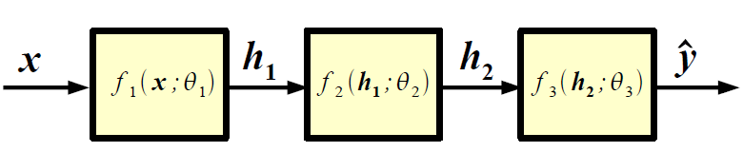
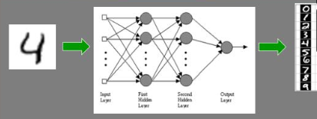
Recall: Neural Nets
NOTE:
In practice, any (a.e. differentiable) non-linear transformation is potentially good.
Example:

